Slide 1
Sales Performance Dashboard
Intern: Ammar Hasware
Dataset: sales_datasample.csv

Slide 2
Objectives
Analyze sales and profit performance
Identify top-performing categories
Understand sales trends
Choose right KPIs (Sales, Profit, Growth)

Slide 3
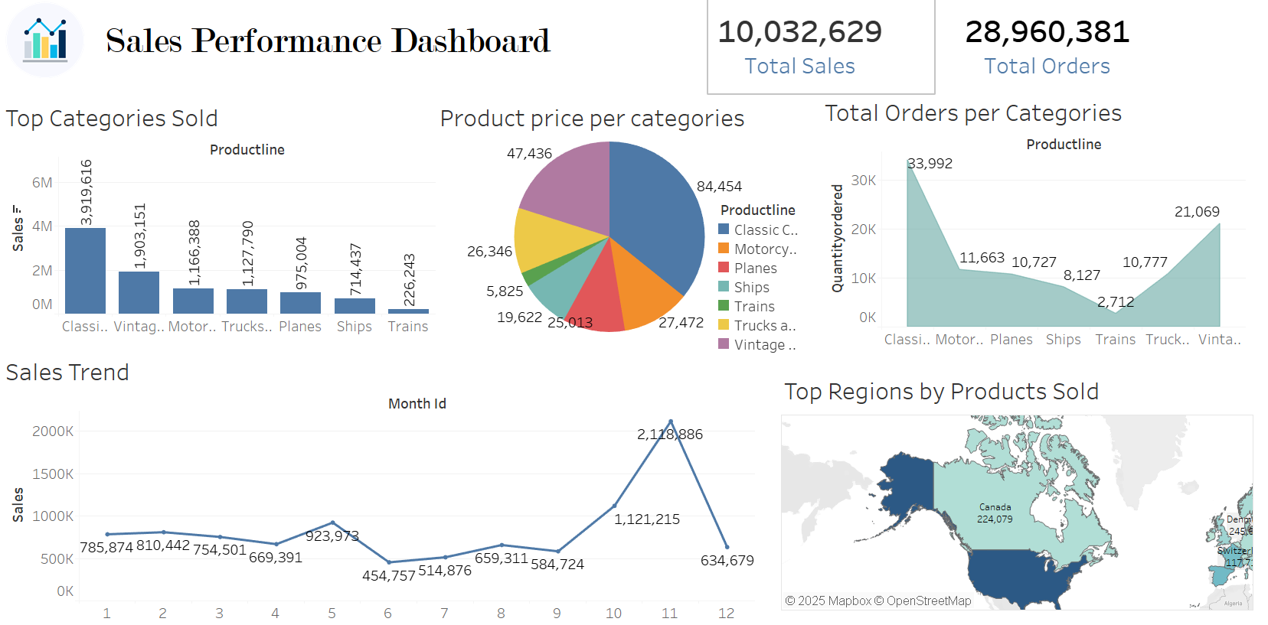
Dashboard Overview

Slide 4
Key Insights
No. of orders are 28.9 Million in which the total sales became 10 Million.
Category of classic cars contributes the highest sales.
Month of November shows strongest demand.
Canada and USA have the most products sold.
Trains have the lowest price range in overall categories.

